Slide 1
WILL THEY CLAIM IT ?
A hackathon by Greyatom
Team
Abhishek Kumar
Abhishek Singh
Nitish Khairnar

Slide 2
Problem Statement
Insurance companies take risks over customers. Risk management is a very important aspect of the insurance industry. Insurers consider every quantifiable factor to develop profiles of high and low insurance risks. Insurers collect vast amounts of information about policyholders and analyze the data.
As a Data scientist in SafeTravel Inc., we have analyzed the available data and predicted whether to sanction the insurance or not.

Slide 3
Why solve this problem ?
SafeTravel Inc. being one of the biggest travel insurance companies in the world, they receive thousands of claims spread across different products
Wrongly denying a claim could lead to lawsuits against the company
Approving the wrong claim would lead to loss.
Hence we need to automatically predict a claim that could lead to a lot of benefits to the company.

Slide 4
Data
Dataset information : The training dataset consists of data corresponding to 52310 customers and the test dataset consists of 22421 customers
There are 10 features available with us to predict whether to sanction the insurance or not.
Features | datatype
ID | Int
Agency | Object
Agency type | Object
Distribution Channel | Object
Product Name | Object
Duration | Int
Destination | Object
Net Sales | Float
Commision | Float
Age | Int
Claim(Target Variable) | Int

Slide 5
Evaluation Metric
The evaluation metric for this project is Precision Score

Slide 6
Data Preprocessing
Dropping the column ‘ID’ from the dataset
Reading the training data and splitting it in Train Test (70/30)
Transforming the non-numericals labels to numericals ones. In our case it ‘Agency’, ‘Agency Type’, ‘Distribution Channel’, ‘Product Name’ and ‘Destination’
Checking correlation between various features
Performing the Chi Square test to determine the interdependence of two variable on each other.

Slide 7
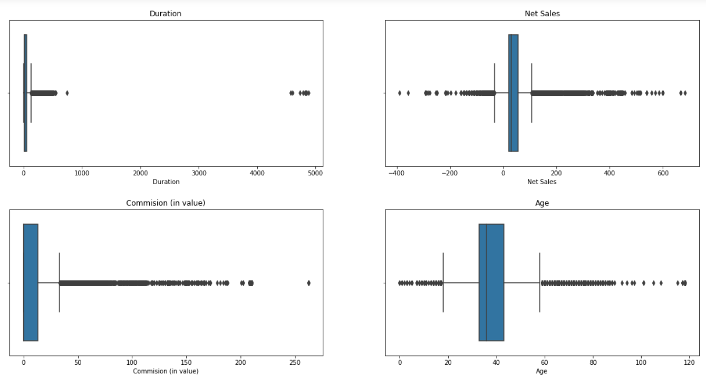
Exploratory Data Analysis
Detecting outliers on ‘Duration’, ‘Net Sales’, ‘Commission’ and ‘Age’

Slide 8
Removing the outliers
From the boxplot of the outliers, we hereby remove the data from Distribution columns which are less than 0 and greater than 1000

Slide 9
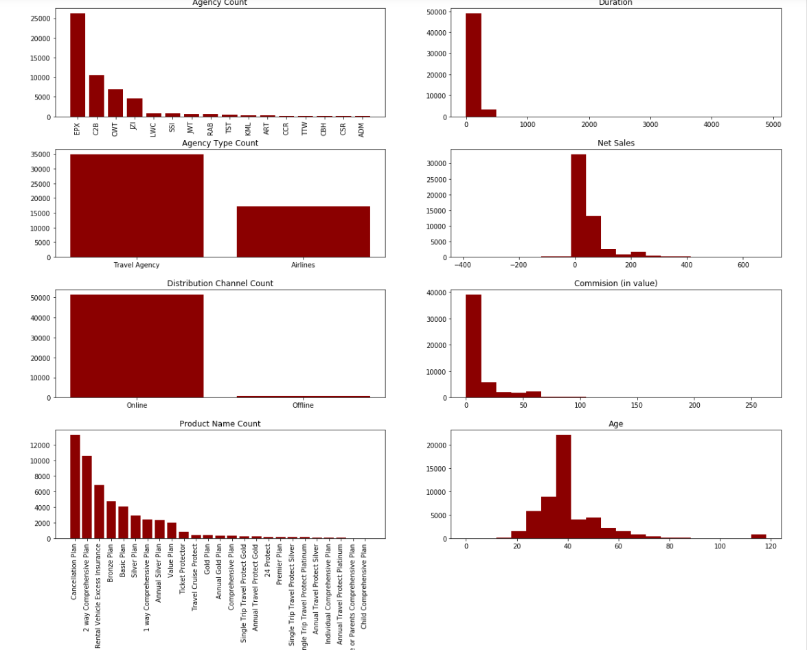
Plotting the bar plot for various features against their value counts to know the frequency

Slide 10
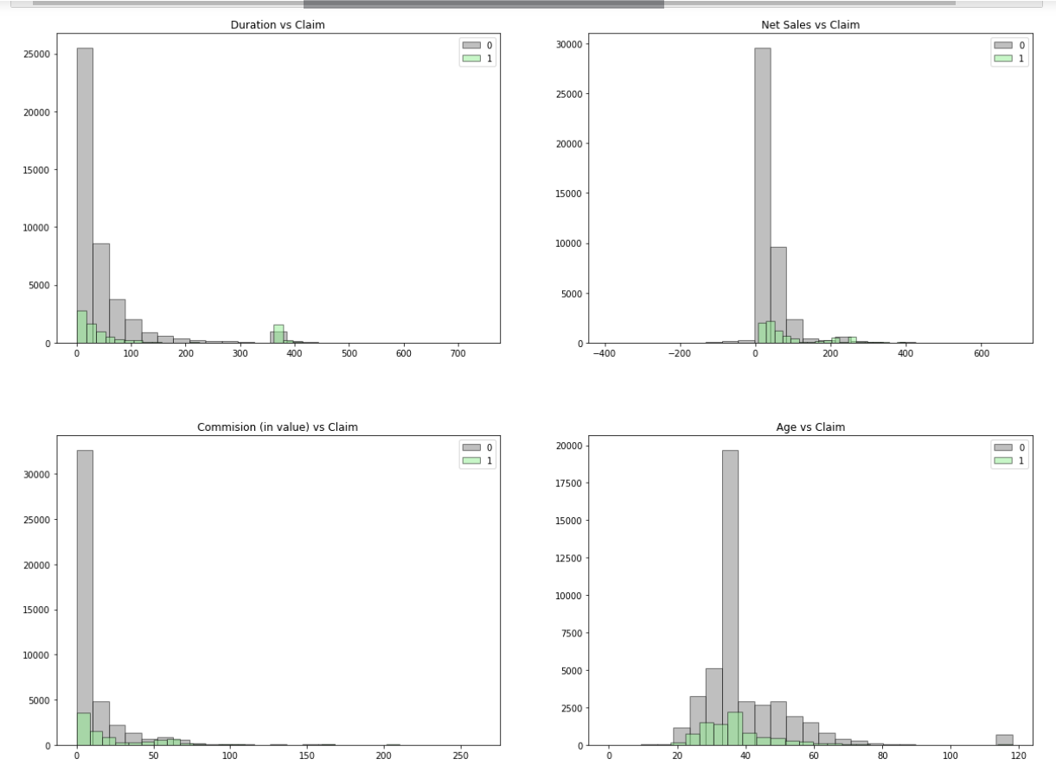
Finding the approvals of claims against the features like Duration, Net Sales, Commission and age

Slide 11
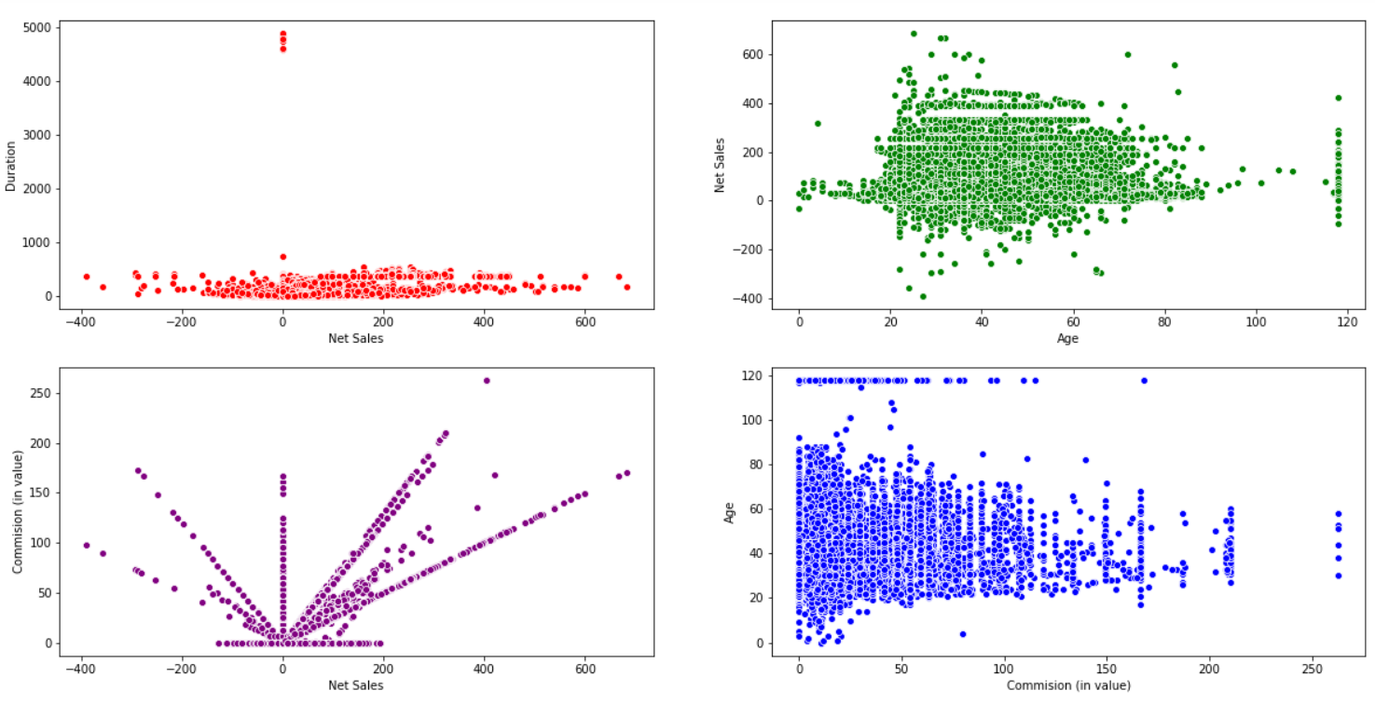
To find the correlation among various features, we will plot the scatter plot

Slide 12
One Hot Encoding
After label encoding, we might confuse our model into thinking that a column has data with some kind of order or hierarchy, when we clearly don’t have it. To avoid this, we ‘OneHotEncode’ that column.
Now when the model is converted the categorical text data into model-understandable numerical data, we can start using the Logistic Regression for our model.
Using the confusion matrix we have our classification report
The Accuracy score of our model is 85.6%
Claim status | Precision | Recall | F1-Score | Support
0 | 0.87 | 0.97 | 0.92 | 13068
1 | 0.64 | 0.31 | 0.41 | 2609
Macro avg | 0.76 | 0.64 | 0.67 | 15677
Weighted avg | 0.84 | 0.86 | 0.83 | 15677

Slide 13
Splitting the data and then making prediction
Using the confusion matrix we have our classification report
The Accuracy score of our model is 84.71%
Claim status | Precision | Recall | F1-Score | Support
0 | 0.86 | 0.97 | 0.91 | 13134
1 | 0.58 | 0.22 | 0.32 | 2559
Macro avg | 0.72 | 0.60 | 0.62 | 15693
Weighted avg | 0.82 | 0.85 | 0.82 | 15693

Slide 14
Using the Random Forest for prediction
Claim status | Precision | Recall | F1-Score | Support
0 | 0.96 | 0.97 | 0.96 | 13134
1 | 0.82 | 0.78 | 0.80 | 2559
Macro avg | 0.89 | 0.88 | 0.88 | 15693
Weighted avg | 0.94 | 0.94 | 0.94 | 15693
The Accuracy score of our model is 93.76%
Using the Decision Tree Classifier for prediction
The Accuracy score of our model is 93.76%
Claim status | Precision | Recall | F1-Score | Support
0 | 0.89 | 0.94 | 0.92 | 13134
1 | 0.57 | 0.41 | 0.48 | 2559
Macro avg | 0.73 | 0.68 | 0.70 | 15693
Weighted avg | 0.84 | 0.85 | 0.84 | 15693
The Accuracy score of our model is 85.45%

Slide 15
Predicting using the GridSearchCV
Claim status | Precision | Recall | F1-Score | Support
0 | 0.96 | 0.96 | 0.96 | 13134
1 | 0.81 | 0.79 | 0.80 | 2559
Macro avg | 0.89 | 0.88 | 0.88 | 15693
Weighted avg | 0.94 | 0.94 | 0.94 | 15693
The Accuracy score of our model is 93.76%
Binary Encoding and Prediction using Binary Encoder
Claim status | Precision | Recall | F1-Score | Support
0 | 0.94 | 0.96 | 0.95 | 13134
1 | 0.76 | 0.66 | 0.71 | 2559
Macro avg | 0.85 | 0.81 | 0.83 | 15693
Weighted avg | 0.91 | 0.91 | 0.91 | 15693
The Accuracy score of our model is 91.08%

Slide 16
Random forest with outlier handling and normalization
By dropping the ‘Agency’ column we are getting accuracy 93.58%
By normalizing the ‘Duration’ column, taking the data points only in the range from 0 to 1000, we are getting the accuracy 93.76%
Applying the One Hot Coding to the new data set, we again try to find out the accuracy.
Normalization is able to acheive 89.31% accuracy with rfc
Scaling is able to acheive 93.65% accuracy with rfc

Slide 17
Random Over Sampling
Now we will perform random over sampling using the imblearn.over_sampling.RandomOverSampler on our new data set.
With this we have the following classification report.
The Accuracy score of our model is 97.07%
Claim status | Precision | Recall | F1-Score | Support
0 | 1.00 | 0.96 | 0.98 | 3113
1 | 0.96 | 1.00 | 0.98 | 2979
Macro avg | 0.98 | 0.98 | 0.98 | 6092
Weighted avg | 0.98 | 0.98 | 0.98 | 6092

